Slide 1
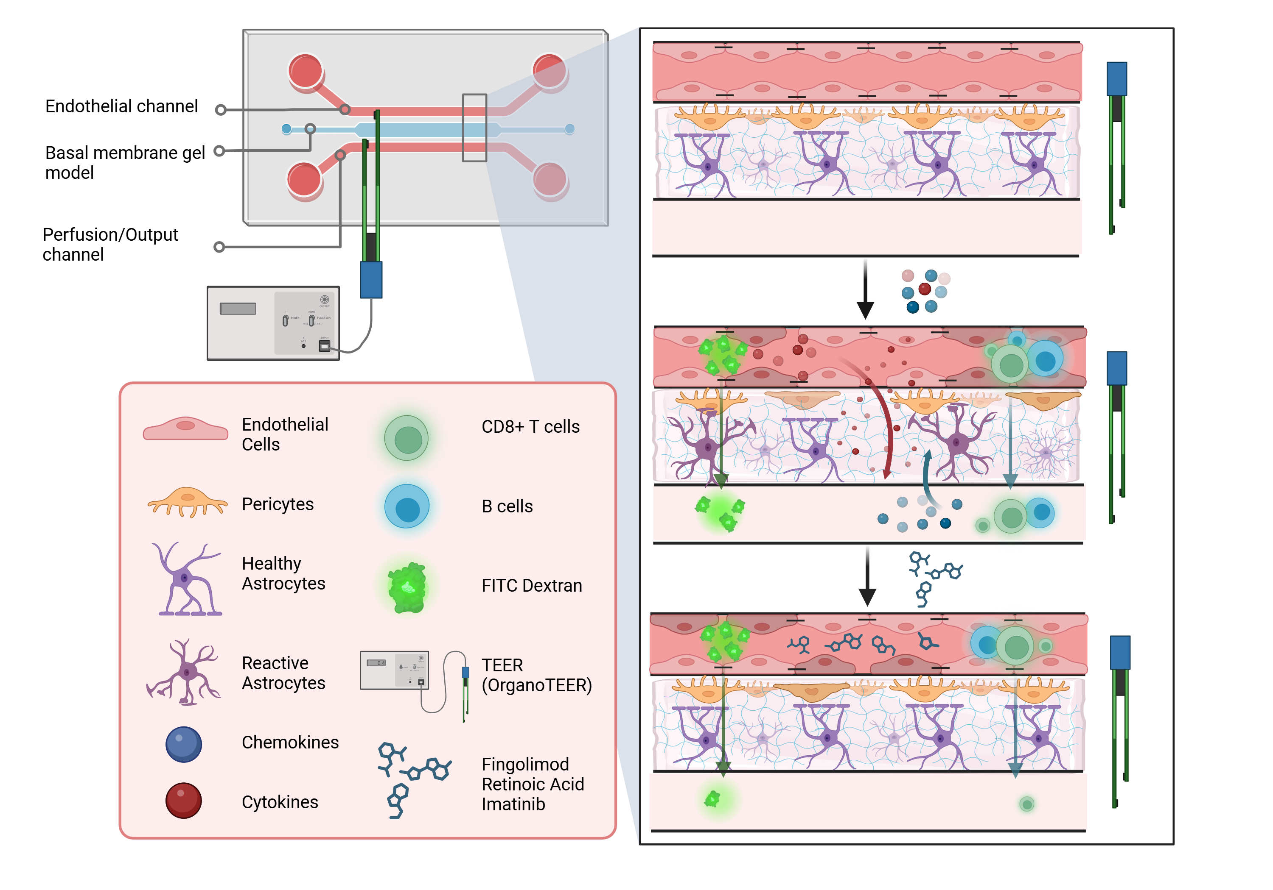

Corso di Laurea Magistrale
in Ingegneria Biomedica
Anno accademico 2024/2025
MIMIC-BBB
Animal-free microfluidic model of Multiple Sclerosis-affected Blood Brain Barrier
Project activity Course of Laboratory of Tissues and physiological processes' models
Carmen Maria Attardo s333803
Alessandra Averardi s333802
Giada Biesso s349048
Claudia D'Agostino s337584
Alessandro Dasi s349093
Alessia Rossi s331666
Tutors: Alice Zoso, Valeria Chiono

Slide 2
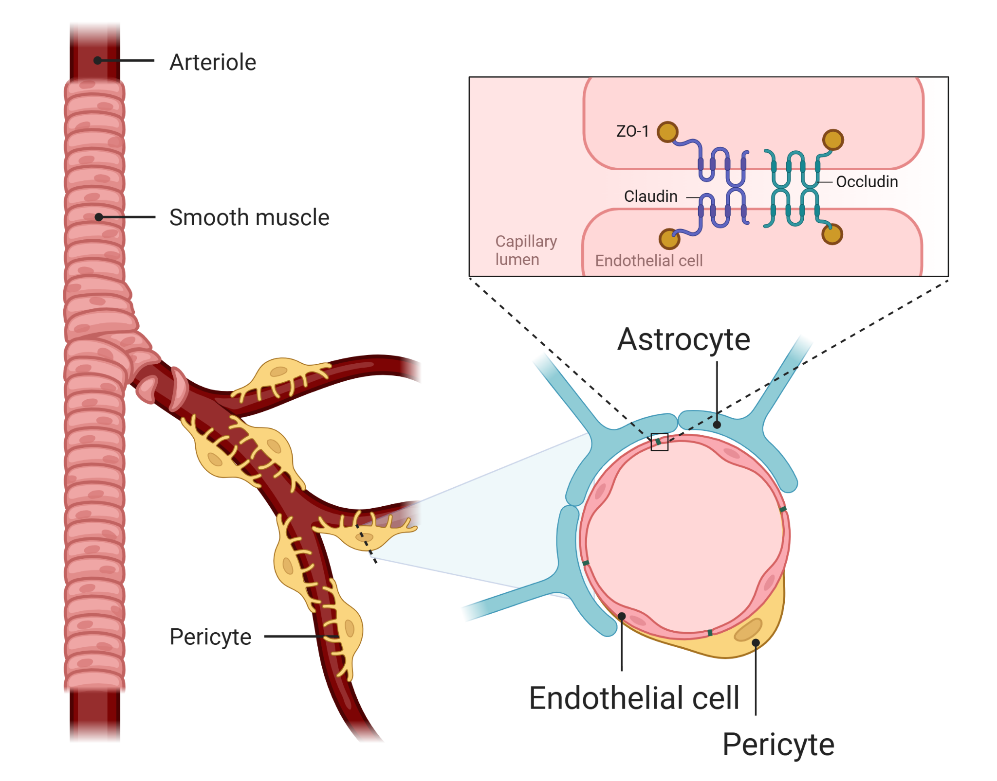
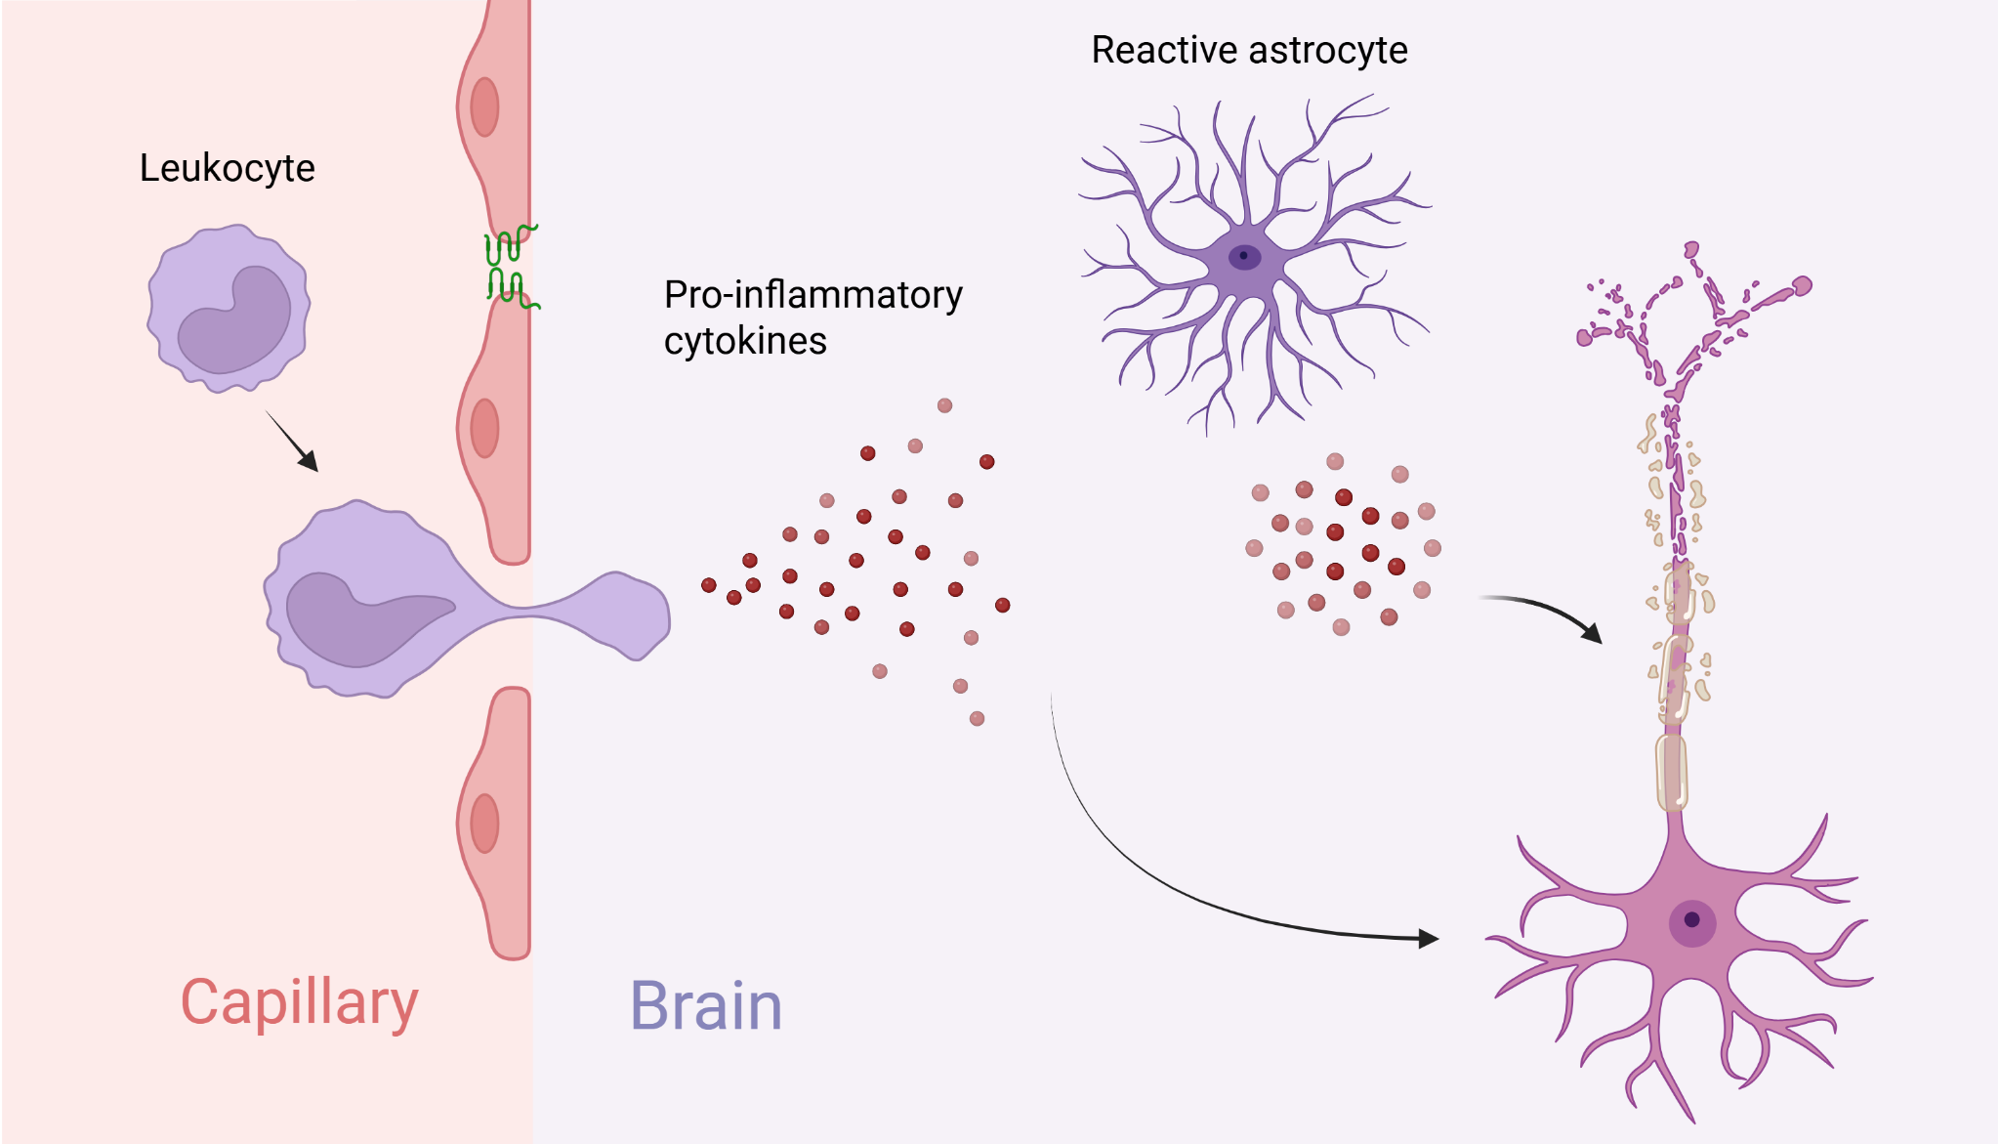
Blood-Brain Barrier and Multiple Sclerosis
BBB: selective barrier regulating the passage of substances between blood and central nervous system
Endothelial cells with tight junctions, astrocytes, and pericytes
Multiple Sclerosis (MS): autoimmune disease characterized by CNS inflammation and demyelination
BBB compromised in MS, with increased permeability leading to autoreactive immune cells infiltration
Chemokine CXCL12 (Stromal Cell-Derived Factor-1) plays a key role in BBB dysfunction during MS
MIMIC - BBB
02/07/2025

Slide 3
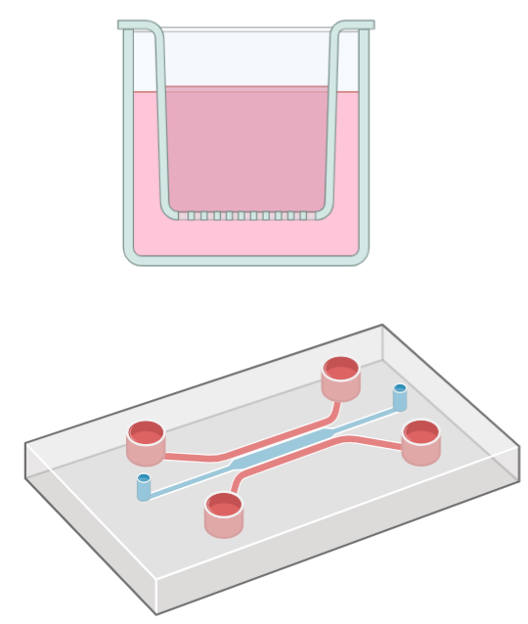
State of the Art
Transwell Models
Microfluidic Systems
Current Problems
Lack of validated in vitro models of BBB-related diseases, especially Multiple Sclerosis
Use of animal-derived matrices, introducing variability
Limited by the lack of shear stress, dynamic flow, and multicellular complexity
Improved BBB simulation with continuous perfusion and better interaction between cell types
MIMIC - BBB
02/07/2025

Slide 4
Aim of the work
Objectives:
1
Design a 3-lane microfluidic model with endothelial and glial components mimicking the structure of the BBB.
2
3
Induce pathological BBB phenotypes using pro-inflammatory cytokines and a CXCL12 chemokine gradient.
Validate the model with known MS therapeutics (Fingolimod, retinoic acid) and test novel candidates (Imatinib).
Establishment of a physiologically relevant BBB-on-a-chip system reproducing MS-like permeability changes and supporting mechanistic insights, therapeutic screenings and future patient-specific applications
Analysis tools
TEER
Evaluation of structural integrity through the visualization of tight junction proteins
Quantitative measure of paracellular permeability
Evaluation of BBB selectivity and permeability to larger objects
Continuous barrier integrity monitoring through automated resistance measures
FITC-Dextran
Immune cell migration assays
Immunofluorescence imaging
MIMIC - BBB
02/07/2025

Slide 5

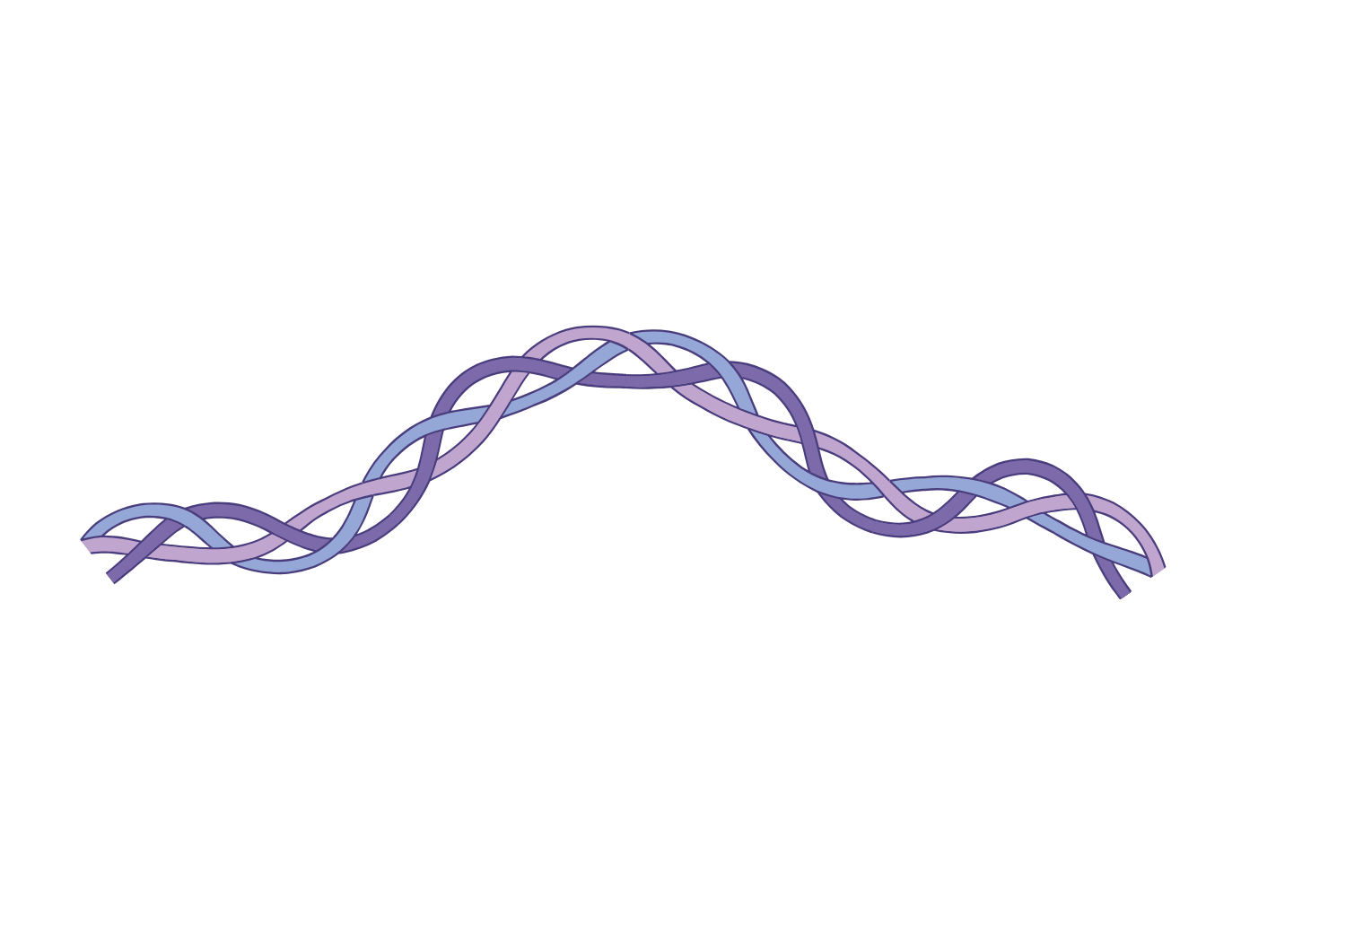
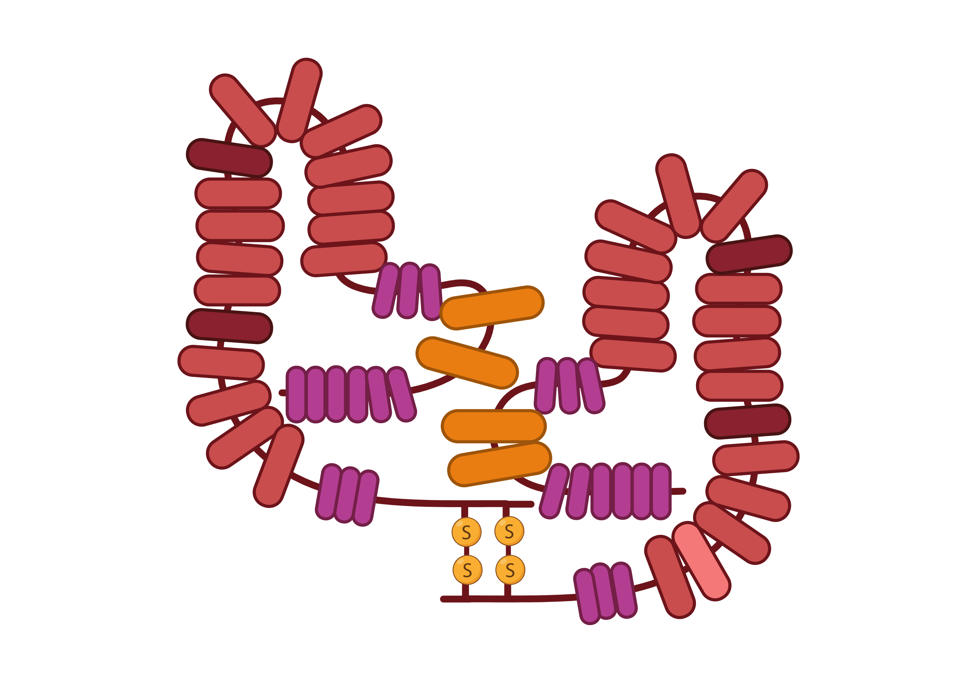

Objective 1 – WP1: Channels preparation
Task 1.1
Microfluidic Channel Preparation & Collagen Gel Optimization
Cell line-derived Human Collagen I (central channel)
Material of choice to simulate brain ECM
Advantages: Xeno-free, reduced variability, supports stable co-culture.
Fibronectin coating (top channel)
For improving endothelial cell adhesion.
Deliverable D1.1: Protocol for optimal collagen gel formulation and casting
Milestone 1.1: Achievement of target collagen gel properties across replicates
Months 1-4
MIMIC - BBB
02/07/2025

Slide 6
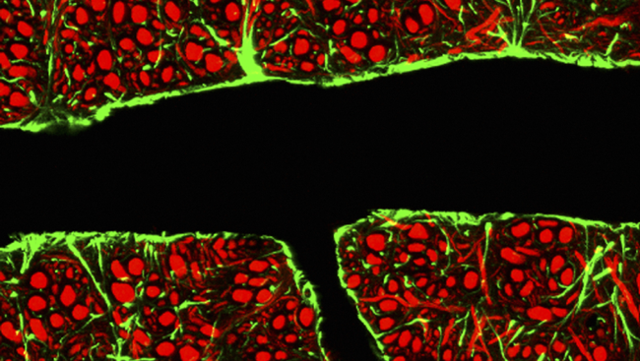
Objective 1 – WP1: Cell culture
Task 1.2: Co-culture Conditions Optimization
TY10 Endothelial Cells
IM-HA Astrocytes and IM-HBVP Pericytes
Glial components essential for BBB stability
3D Co-culture
Human cell line with an above average tight junction formation capability
In collagen gel to simulate BBB structure
Deliverable D1.2: Standardized co-culture protocol to ensure a consistent barrier formation
Milestone M1.2: Stable TEER values ≈ 20 Ω·cm²
Months 3-9
MIMIC - BBB
02/07/2025

Slide 7
Objective 2 – WP2: Inducing Pathological Permeability
Months 10-18
Task 2.1 Inflammatory Stimulation
Introduction through the perfusion channels of TNF-α, IL-1β and CXCL12 into the model
These stimuli mimic MS-related BBB inflammation
Milestone 2.1
≥75% TEER reduction from baseline
Task 2.2 Permeability Validation
Use of FITC–dextran tracers and immune cell migration assays (Jurkat CD8+ T-cells, Lymphoblastoid cell line)
Deliverable D2.1
Dose-response curve protocol for inflammatory stimulation
Deliverable D2.2
Validated workflow for dual TEER/tracer permeability quantification
Milestone M2.2
Confirmed TEER/diffusion correlation for pathological models
MIMIC - BBB
02/07/2025

Slide 8
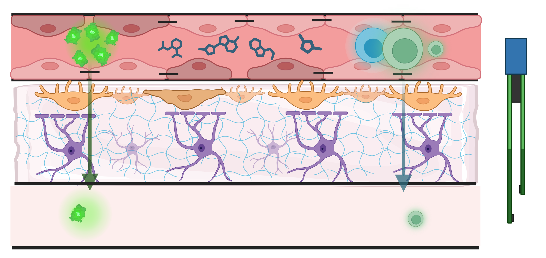
Objective 3 - WP3: Model Validation with Established Therapeutics
Months 19-24
Task 3.2: Evaluation of Functional Recovery
Deliverable D3.2: Functional recovery dataset
Milestone M3.2: Recovery of structural and functional parameters
Task 3.1: Administration of Fingolimod and Retinoic Acid, alone and in combination
Deliverable D3.1: Dose-optimization protocol for therapeutic rescue
Milestone M3.1: Demonstrated TEER recovery ≥ 70% of baseline following treatment
MIMIC - BBB
02/07/2025

Slide 9
Objective 3 - WP4: Further Drug Screening and Statistical Analysis
Months 1-24
Task 4.1
Task 4.2
Imatinib efficacy comparison with Fingolimod/Retinoic Acid
Comparative dataset on permeability modulating effects of Imatinib vs. standard drugs
Statistically significant difference in permeability (p<0.05) between Imatinib and control
Statistical modelling, final reporting
Peer-review suitable manuscript
Final model robustness validation, report data choice
Imatinib
New candidate drug, to be tested under the same conditions as the established compounds
Deliverable D4.1
Deliverable D4.2
Milestone M4.1
Milestone M4.2
MIMIC - BBB
02/07/2025

Slide 10
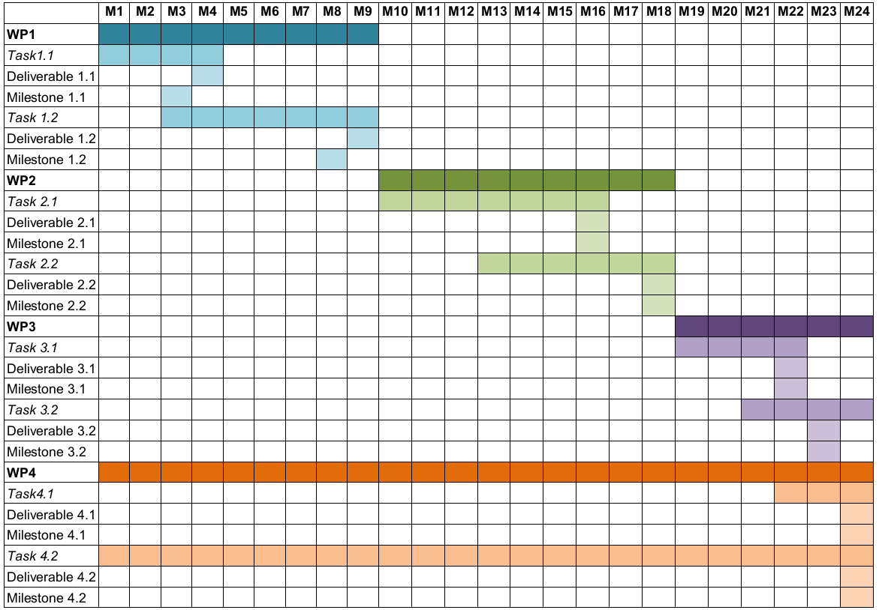
Gantt chart - Project timeline
MIMIC - BBB
02/07/2025

Slide 11
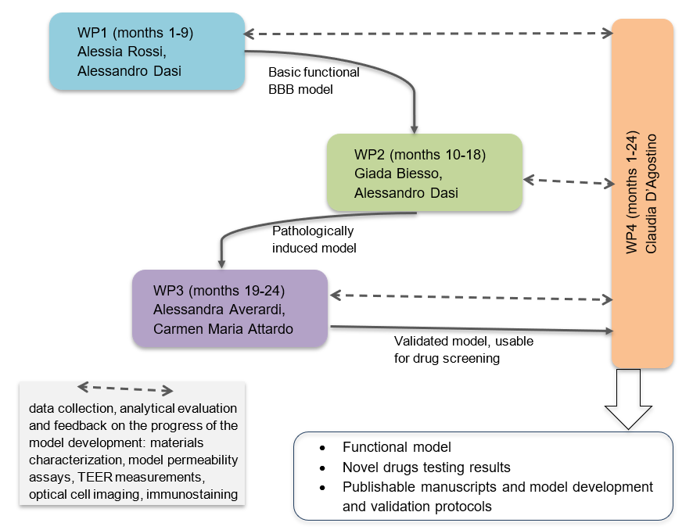
PERT diagram – Project roles
MIMIC - BBB
02/07/2025

Slide 12





Contingency Plan
Collagen properties variability between batches: pH/gel ratio adjustments, possible supplementation of alternative commercial human ECM products
Insufficient baseline TEER Values: Increase in cell density, exclusion of materials’ defects via testing with Transwell backup systems
Drug solubility issues: Use of cosolvents or drug encapsulation; solubility pretests
Shear Stress values incompatible with barrier formation: Flow parameters recalibration, optional pump use
Cytokine-induced Cytotoxicity: Reduction in cytokine concentrations or exposure times; non-joint exposure
MIMIC - BBB
02/07/2025

Slide 13
Compliance to the 3Rs principle
Replacement
Reduction & Refinement
Preliminary drug screenings in vitro to refine the design of subsequent in vivo experiments and potentially reduce the number of animals required for later-stage validation by narrowing down drug candidates and optimizing dosage ranges
Fully human model with no animal-derived components: use of cell-line derived human collagen I and TY10, IM-HA and IM-HBVP cell lines, with efforts to utilize FBS and animal products-free mediums for their culture
Outcome
Ethical, robust, and scalable alternative to animal-based BBB research and drug screening
MIMIC - BBB
02/07/2025

Slide 14
Impact of the project
Scientific Innovation
Human-based BBB model mimicking MS pathological permeability
Enables mechanistic insights beyond animal models or basic in vitro setups
Methodological Contribution
Scalable, automated, and reproducible system using Organoplate® 3-lane 40
Standardized protocols and materials promote broader adoption
Translational Value
Validated screening platform for emerging compounds
Ethical & Economic Gains
3Rs compliance
Preclinical costs reduction: more stramlined and efficient drug screening process
Future patient-specific applications throught he use of iPSC-derived cells
MIMIC - BBB
02/07/2025

Slide 15
Conclusions
Fully human, animal-free BBB model using a microfluidic platform
Reproduces MS-related permeability dysfunction using inflammatory cues
Validated through standard MS therapies
Ethical, scalable alternative for in vitro drug screening
Supports 3Rs principles, promoting reproducibility and reducing animal use
Future developments
Integrate iPSC-derived patient-specific cells for personalized disease modeling
Expand platform to study other neurological disorders
Incorporate immune components to model neuroinflammatory responses in real time
Develop predictive analytics using AI on permeability and TEER datasets
Align with preclinical pipelines for early safety screening and regulatory readiness
MIMIC - BBB
02/07/2025

Slide 16
Thank you for the attention!
And we thank Dr. Valentina Averardi for her contribution in the choice of the drugs for model validation and drug testing

Slide 17
Sitography
OrganoPlate 3-lane 40: https://www.mimetas.com/en/organoplate-3-lane-40/
OrganoTEER: https://www.mimetas.com/en/organoteer-/
Collagen IV for endothelial cells preculture: https://www.sigmaaldrich.com/IT/it/product/sigma/c6745
Collagen I for gel formation: https://www.cellgs.com/products/opticoland8482-human-collagen-type-i-3-mgml-60-mg.html
Immortalized human astrocytes: https://innoprot.com/product/immortalized-human-astrocytes/
Astrocyte medium: https://www.clinisciences.com/en/other-products-186/astrocyte-medium-2000186.html
Immortalized human brain vascular pericytes: https://innoprot.com/product/immortalized-human-brain-vascular-pericytes/
Pericyte medium: https://www.clinisciences.com/en/other-products-186/pericyte-medium-2000181.html
Serum-free endothelial cell medium: https://www.clinisciences.com/en/other-products-186/serum-free-endothelial-cell-medium-394000025.html
Human recombinant fibronectin for channel coating: https://www.rndsystems.com/products/recombinant-human-fibronectin-protein-cf_4305-fnb
Recombinant monoclonal antibodies: https://www.thermofisher.com/antibody/product/Occludin-Antibody-clone-6H10L9-Recombinant-Monoclonal/701161
https://www.thermofisher.com/antibody/product/ZO-1-Antibody-clone-ZO1-1A12-Recombinant-Monoclonal/740002M
https://www.thermofisher.com/antibody/product/Claudin-5-Antibody-clone-JM11-22-Recombinant-Monoclonal/MA5-32614

